Slide 1
CSE 390
Lecture 9
Version control and Subversion (svn)
slides created by Marty Stepp, modified by Josh Goodwin
http://www.cs.washington.edu/390a/

Slide 2
Working Alone
Ever done one of the following?
  Had code that worked, made a bunch of changes and saved it, which broke the code, and now you just want the working version back…
  Accidentally deleted a critical file, hundreds of lines of code gone…
  Somehow messed up the structure/contents of your code base, and want to just “undo” the crazy action you just did
  Hard drive crash!!!! Everything’s gone, the day before deadline.
Possible options:
  Save as (MyClass-old.java)
    Ugh. Just ugh. And now a single line change results in duplicating the entire file…
  RAID to protect your files
    That’s one pricey laptop

Slide 3
Working in teams
  Whose computer stores the "official" copy of the project?
    Can we store the project files in a neutral "official" location?
  Will we be able to read/write each other's changes?
    Do we have the right file permissions?
    Lets just email changed files back and forth! Yay!
  What happens if we both try to edit the same file?
    Bill just overwrote a file I worked on for 6 hours!
  What happens if we make a mistake and corrupt an important file?
    Is there a way to keep backups of our project files?
  How do I know what code each teammate is working on?

Slide 4
Solution: Version Control
version control system: Software that tracks and manages changes to a set of files and resources.
You use version control all the time
  Built into word processors/spreadsheets/presentation software
    The magical “undo” button takes you back to “the version before my last action”
  Wiki’s
    Wiki’s are all about version control, managing updates, and allowing rollbacks to previous versions

Slide 5
Software Version control
Many version control systems are designed and used especially for software engineering projects
  examples: CVS, Subversion (SVN), Git, Monotone, BitKeeper, Perforce
helps teams to work together on code projects
  a shared copy of all code files that all users can access
  keeps current versions of all files, and backups of past versions
  can see what files others have modified and view the changes
  manages conflicts when multiple users modify the same file
  not particular to source code; can be used for papers, photos, etc.
    but often works best with plain text/code files

Slide 6
Repositories
repository: Central location storing a copy of all files.
  check in: adding a new file to the repository
  check out: downloading a file from the repo to edit it
    you don't edit files directly in the repo; you edit a local working copy
    once finished, the user checks in a new version of the file
  commit: checking in a new version of a file(s) that were checked out
  revert: undoing any changes to a file(s) that were checked out
  update: downloading the latest versions of all files that have been recently committed by other users

Slide 7
Repository Location
Can create the repository anywhere
  Can be on the same computer that you’re going to work on, which might be ok for a personal project where you just want rollback protection
But, usually you want the repository to be robust:
  On a computer that’s up and running 24/7
    Everyone always has access to the project
  On a computer that has a redundant file system (ie RAID)
    No more worries about that hard disk crash wiping away your project!
Hint: attu satisfies both of these

Slide 8

Subversion
Subversion: created to repair problems with older CVS system
  supports folders, better renaming, atomic commits, good branching
  currently the most popular free open-source version control system
installing in Ubuntu:
  $ sudo apt-get install subversion
installing in Fedora:
  System->Administration->Add/Remove Software
  Search for “subversion”
command | description
svnadmin | make administrative changes to an SVN repository
svn | interact with an SVN repository

Slide 9
SVN commands
command | description
svn add files | schedule files to be added at next commit
svn ci [files] | commit / check in changed files
svn co files | check out
svn help [command] | get help info about a particular command
svn import directory | adds a directory into repo as a project
svn merge source path | merge changes
svn revert files | restore local copy to repo's version
svn resolve source path | resolve merging conflicts
svn update [files] | update local copy to latest version
others: blame, changelist, cleanup, diff, export, ls/mv/rm/mkdir, lock/unlock, log, propset

Slide 10
Setting up a repo
on attu, create the overall repository:
  $ svnadmin create path
from attu, add initial files into the repo (optional):
  $ svn import projectname foldername
give the repo read/write permissions to your project group
  $ chgrp -R myprojectgroup repofoldername
  $ chmod -R g+rwX,o-rwx repofoldername
Exercise: Create a repository on attu

Slide 11
Adding files to a repo
on your computer, set up a local copy of the repo
  $ svn co svn+ssh://attu.cs.washington.edu/foldername
  or, if you're setting up your local copy on attu as well:
  $ svn co file:///homes/iws/username/foldername
  after checkout, your local copy "remembers" where the repo is
now copy your own files into the repo's folder and add them:
  $ svn add filename
  common error: people forget to add files (won't compile for others)
added files are not really sent to server until commit
  $ svn ci filename -m "checkin message"
  put source code and resources into repo (no .o files, executables)

Slide 12
Committing changes
updating (to retrieve any changes others have made):
  $ svn update
examining your changes before commit:
  $ svn status
  $ svn diff filename
  $ svn revert filename
committing your changes to the server:
  $ svn ci -m “added O(1) sorting feature”
  Version control tip: use good commit messages!
Exercise: check out the repository, add some files, and commit them

Slide 13
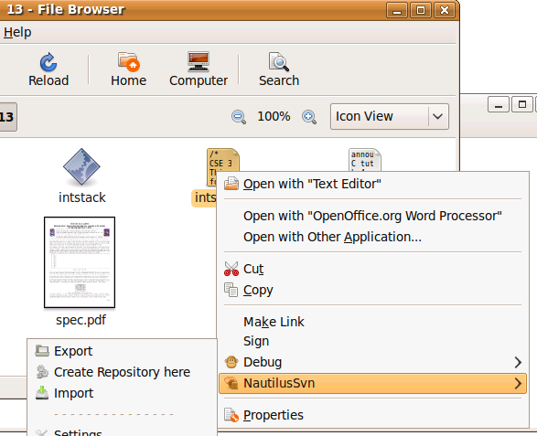
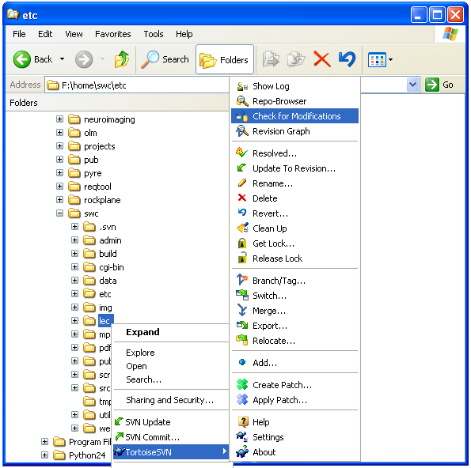
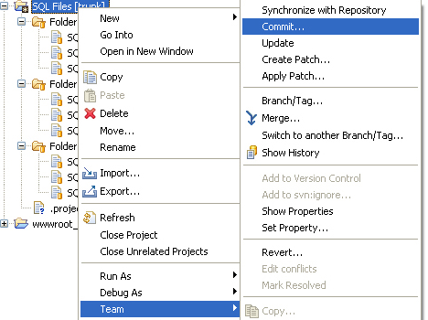
Shell/IDE integration
Linux:
NautilusSVN
Windows:
TortoiseSVN
Eclipse:
Subclipse

Slide 14
TortoiseSVN
Available at http://tortoisesvn.net/
Nice graphical interface for windows users
To use on a repository located on attu:
  Need to use the svn+ssh syntax:
    svn+ssh://username@attu.cs.washington.edu/repopath
Exercise: Check out our repository, modify a file, add a file, and commit our changes

Slide 15
What’s actually going on?
Take a look inside the svn project folder…
  Where the heck are our committed files?
  Take a look at the readme…
Everything is stored in SVN’s database structure
  So, even though you might have 100 versions of a file, there’s not 100 copies of that file
    Database stores the diff from version to version
    Helps more efficiently store a large codebase across hundreds of versions
  Don’t worry about the details. Just don’t mess with the repository directly!

Slide 16
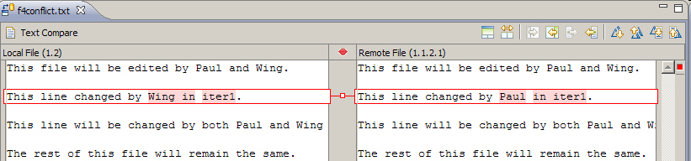
Merging and conflicts
merge: Two sets of changes applied at same time to same files
  happens when two users check out same file(s), both change it, and:
    both commit, or
    one changes it and commits; the other changes it and does an update
conflict: when the system is unable to reconcile merged changes
  resolve: user intervention to repair a conflict. Possible ways:
    combining the changes manually in some way
    selecting one change in favor of the other
    reverting both changes (less likely)

Slide 17
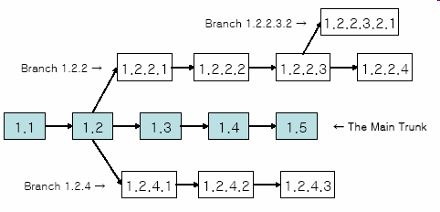
Branches
branch (fork): A second copy of the files in a repository
  the two copies may be developed in different ways independently
  given its own version number in the version control system
  eventually be merged
  trunk (mainline, baseline): the main code copy, not part of any fork

Slide 18
Learn what you need
Creating branches and using merge tools are usually more than you need for any curriculum projects
  Personally not a fan of the conflict resolution tools – I’ll usually just back up my conflicted file, update so I now have the current version, then manually merge my changes with the updated files
  I’ve never had any good reason to create a branch in a department project
But, they are definitely used in industry, and you should at least know about them

Slide 19
Another view: Git
Git is another popular version control system.
Main difference:
  SVN:
    central repository approach – the main repository is the only “true” source, only the main repository has the complete file history
    Users check out local copies of the current version
  Git:
    Distributed repository approach – every checkout of the repository is a full fledged repository, complete with history
    Greater redundancy and speed
    Branching and merging repositories is more heavily used as a result
Takeaway: There are differences beyond just differently named commands, learn about a tool before using it on a critical project!

Slide 20
Wrap-up
You *will* use version control software when working on projects, both here and in industry
  Rather foolish not to
  Advice: just set up a repository, even for small projects, it will save you time and hassle
Lots of online options for free open source code hosting
  Google code, Git hub, JavaForge, SourceForge…
  All use version control to manage the code database
Any experiences with version control, positive/negative?

